Slide 1

Project – Machine Learning for 3D Geometry
Single and Multi-View 3D Reconstruction from 2D Images: Vision Transformers
Biray Sutcuoglu
Youssef Youssef
Michael Kubitza

Slide 2
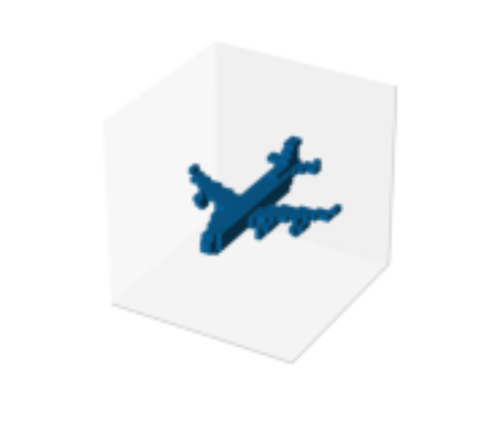
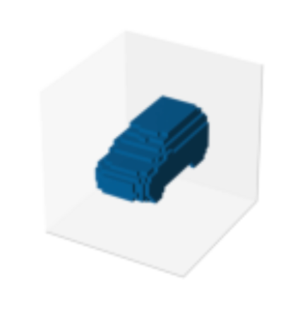
Motivation
Traditional methods for 3D shape reconstruction rely on matching observed objects with suitable 3D shape priors, requiring prior knowledge or adaptation
3D-R2N2: network takes one or more images of an object instance and outputs a 3D occupancy grid reconstruction
This approach does not require object class labels or image annotations, making it flexible and applicable across diverse objects and scenarios

Slide 3
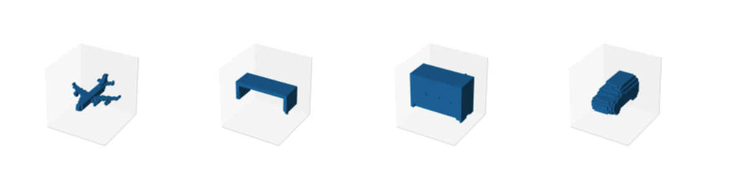
Approach
The architecture of 3D-RETR was re-implemented and trained from the ground up
3D-RETR-Deep-Fusion employs a transformer to effectively learn an appropriate fusion of multiple image views
Considering the limitations in available resources, the experimental outcomes on ShapeNet demonstrate that both models achieve results nearly on par with state-of-the-art methods

Slide 4
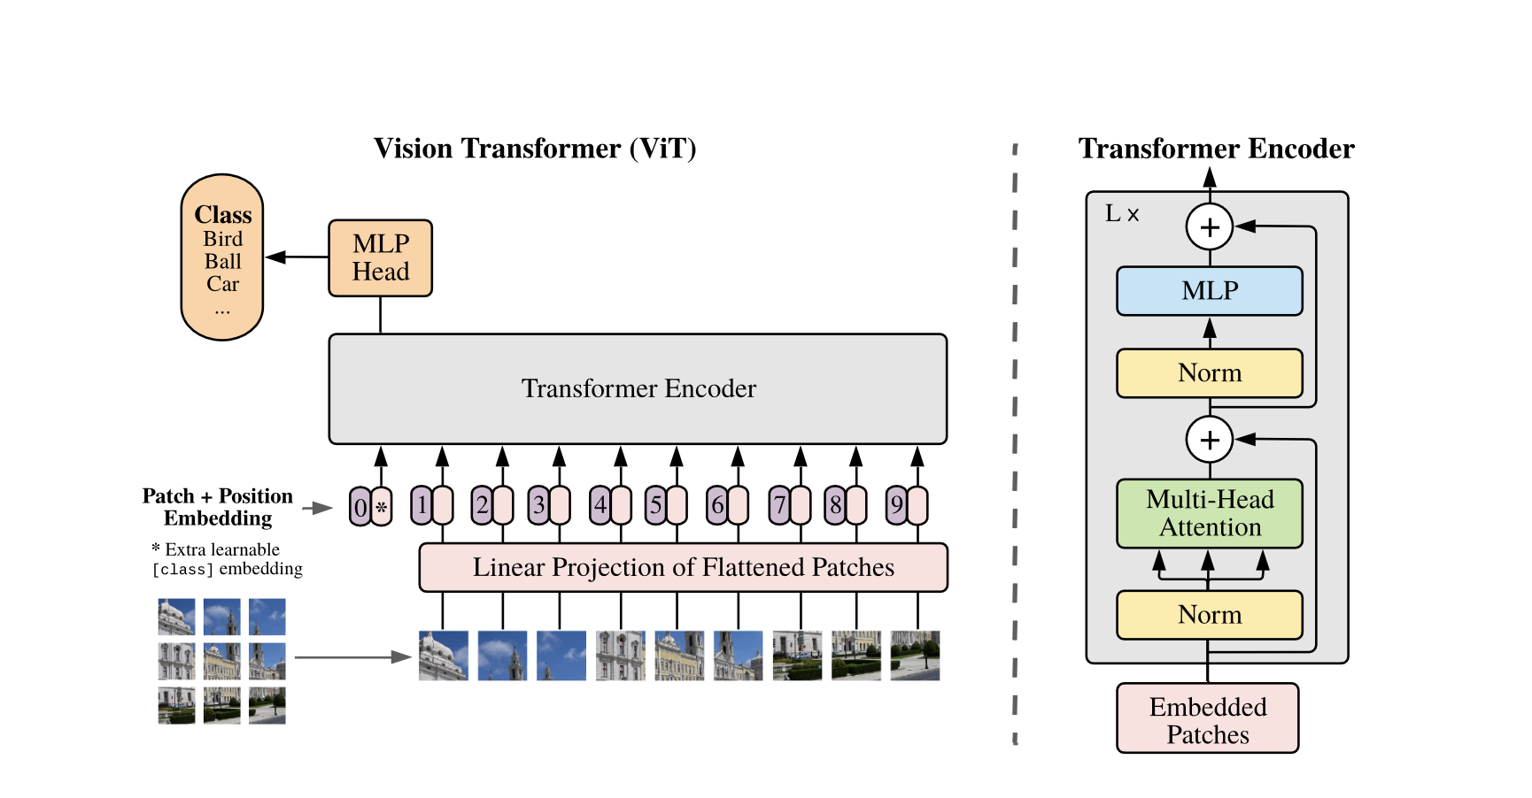
Vision Transformer
This approach is to represent a 2D image as a sequence of patches
Each patch is transformed into a higher-dimensional vector, which is subsequently fed into a transformer model
In multi-view image fusion, the conventional approach involves averaging the features from all image views
Notes:
However, this simplistic method may not yield accurate results, especially when dealing with views from different angles
To address this limitation, we propose a view fusion transformer that learns how to effectively combine multiple views for improved fusion.

Slide 5
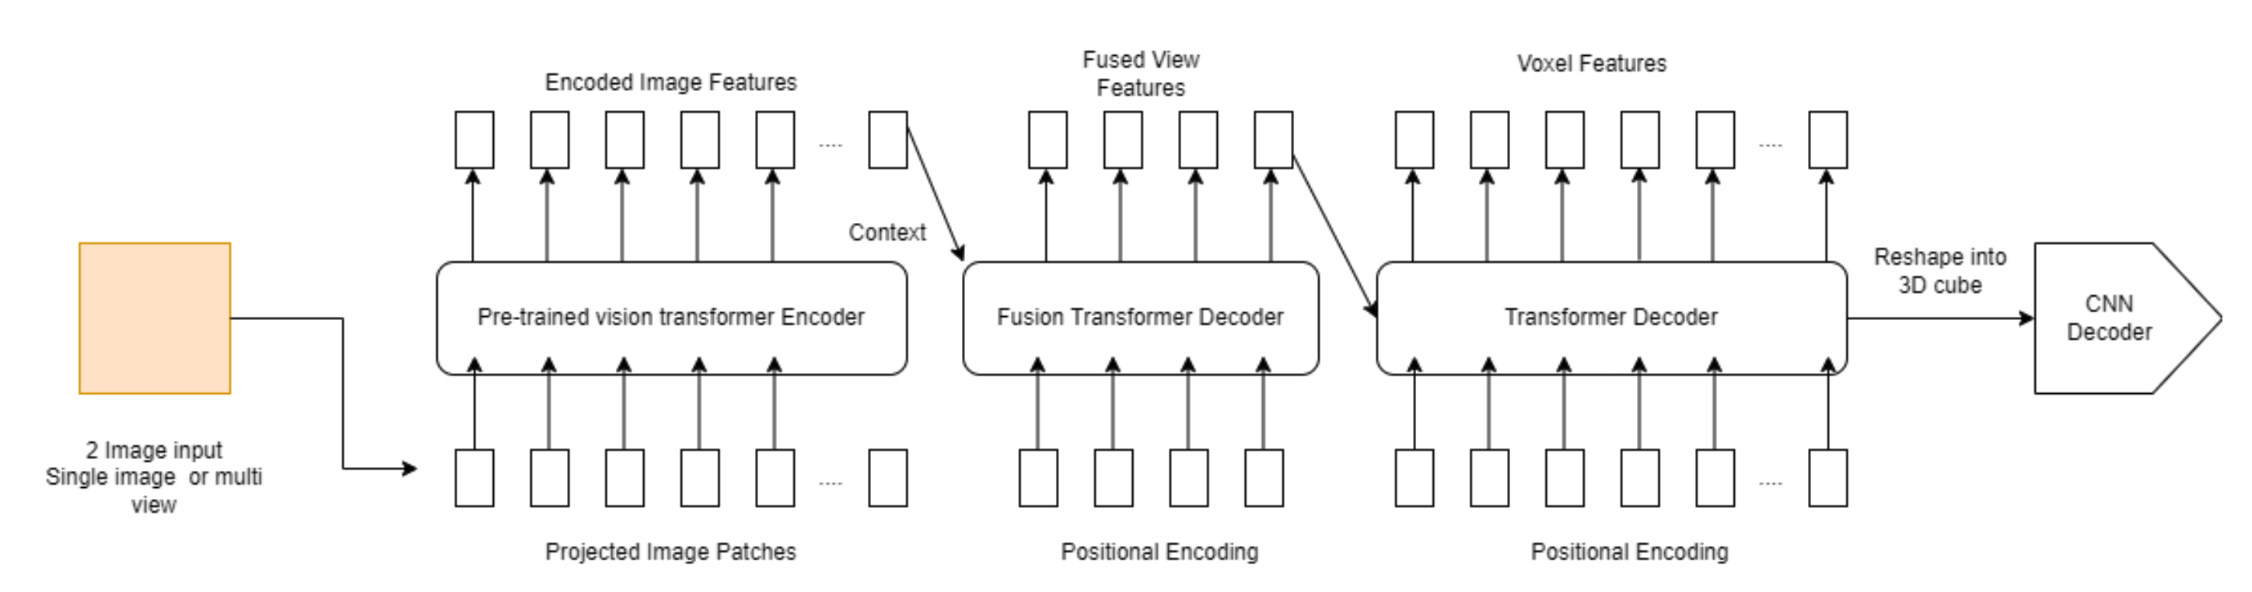
3D-RETR-Deep-Fusion

Slide 6
Training
ShapeNet dataset (80% training, 10% validation and 10% testing)
3 models trained:
3D-RETR-Avg-Fusion
3D-RETR-Deep-Fusion
3D-RETR-Avg-Fusion-E
Notes:
• 3D-RETR-Avg-Fusion this is our implementation of the 3D-RETR-B model
• 3D-RETR-Deep-Fusion this is our extension with the transformer for multi-view fusion
• 3D-RETR-Avg-Fusion-E this is the same as the 3D- RETR-Avg-Fusion model but stopped early during training

Slide 7
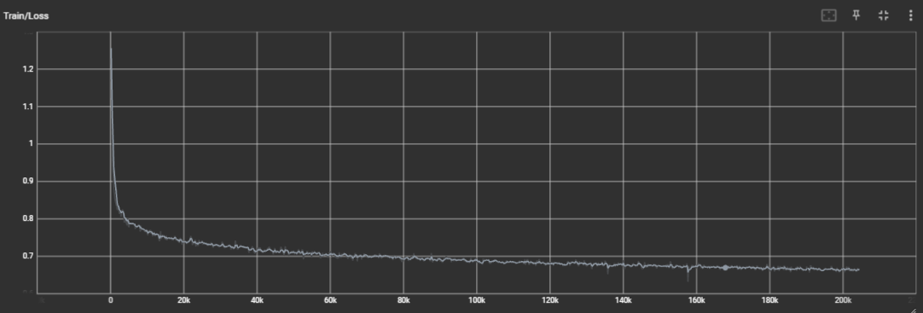
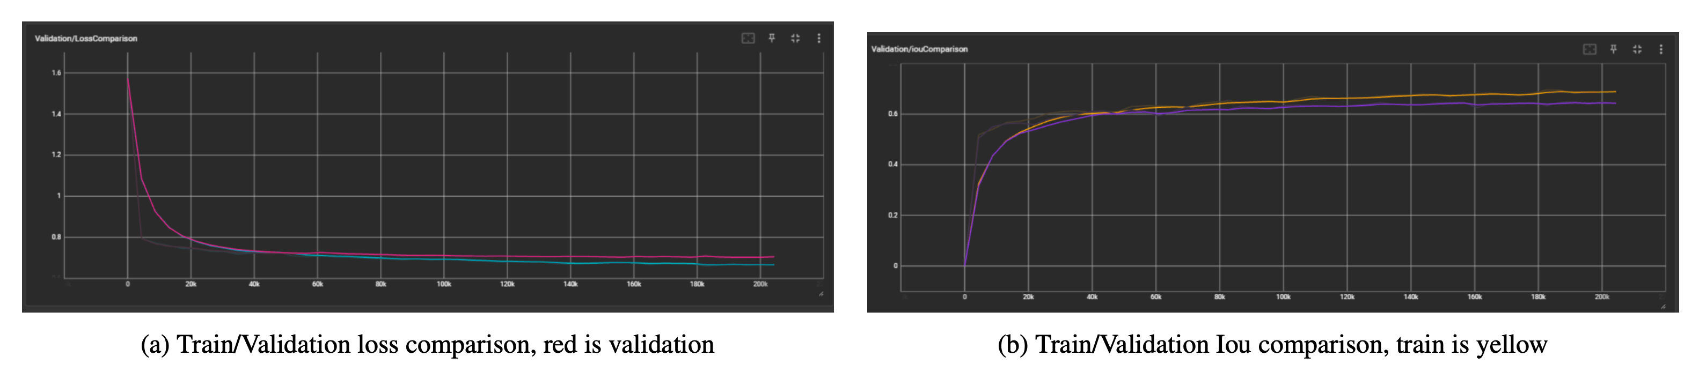
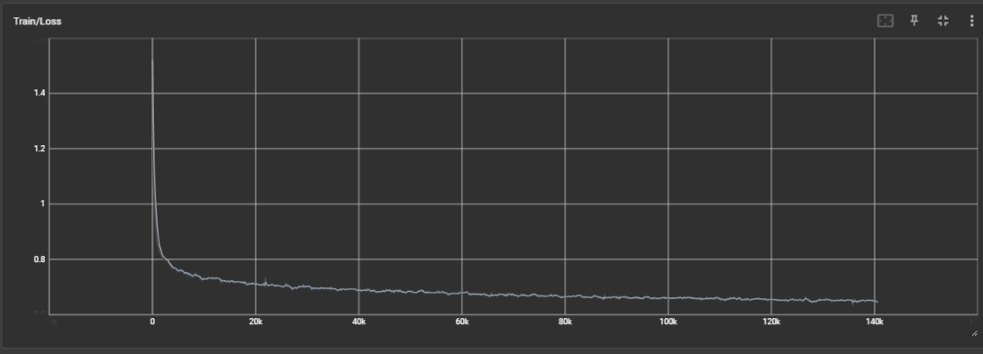
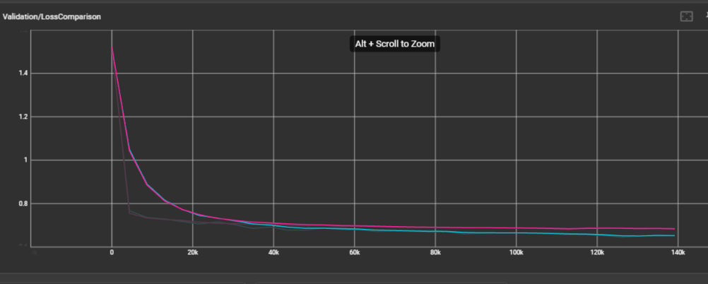
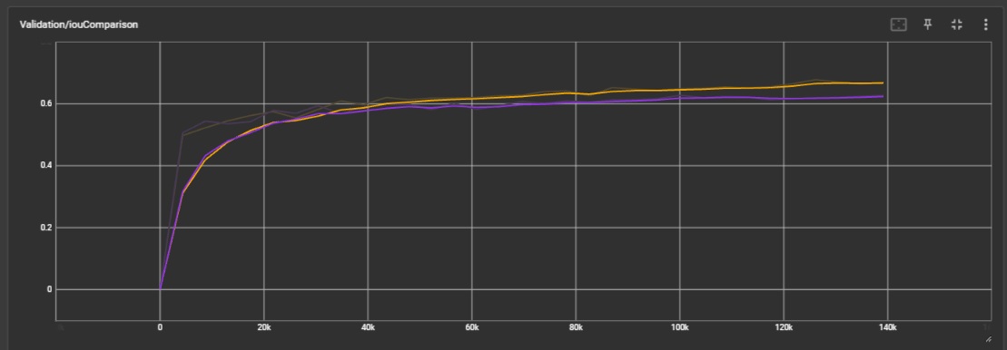
Training
3D-RETR-Avg-Fusion Training Process
3D-RETR-Deep-Fusion Training Process

Slide 8
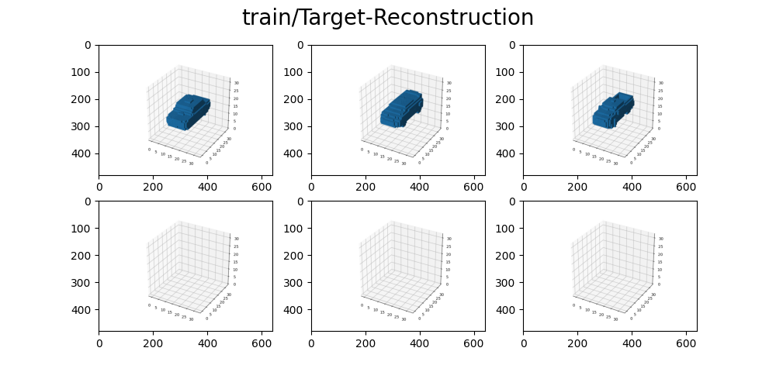
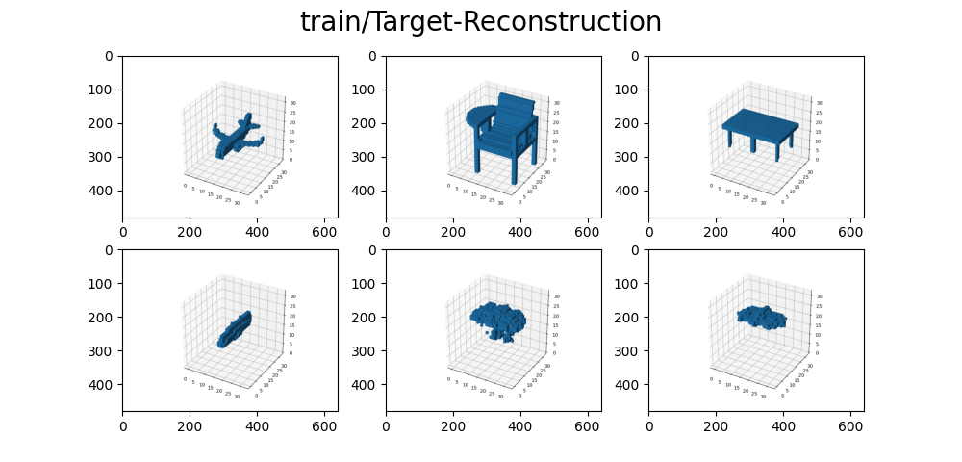
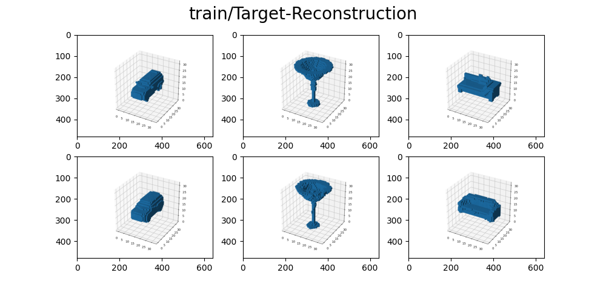
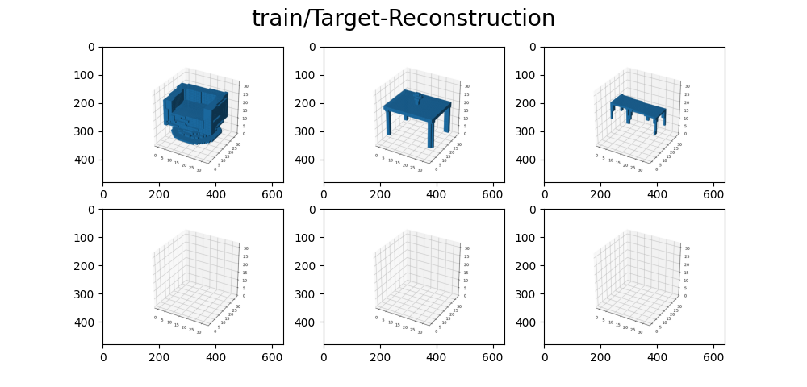
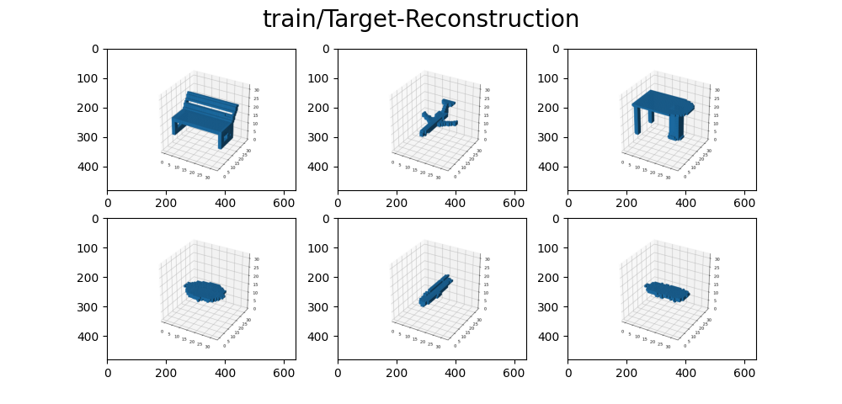
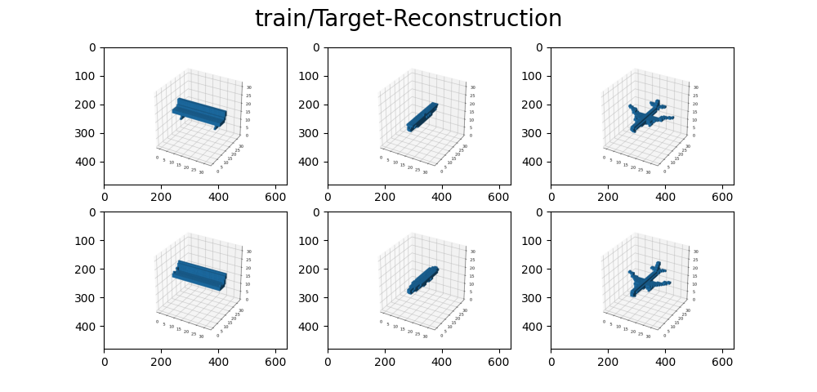
Training Reconstruction Improvements
3D-RETR-Avg-Fusion Training Process
Step 0
Step 149
Step 149k
3D-RETR-Deep-Fusion Training Process
Step 0
Step 300
Step 85k
8

Slide 9
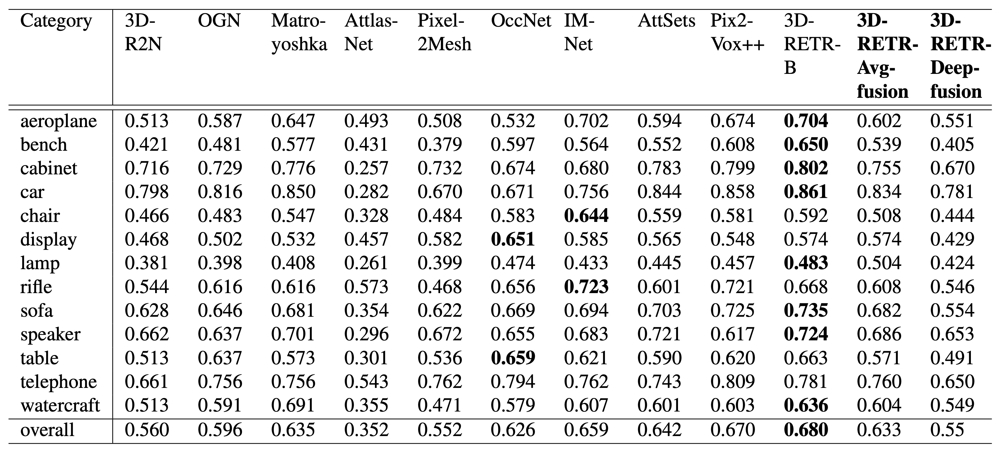
Results
As predicted, the deep fusion model underperforms in this scenario
On the contrary, our average fusion implementation excels as a top-performer

Slide 10
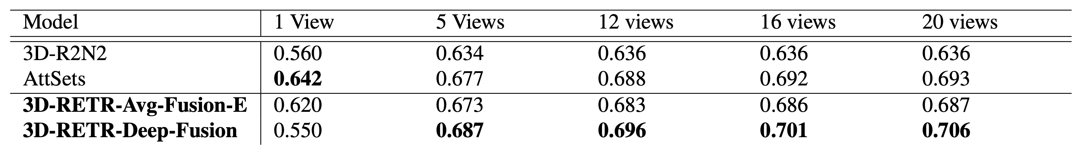
Results
Performance results of various models in the multi-view setting, measured by the overall Intersection over Union (IoU) across all classes.

Slide 11
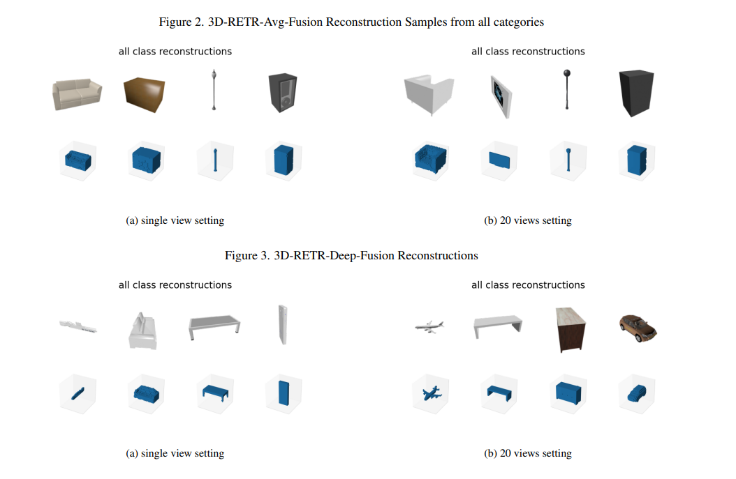
Average & Deep Fusion Reconstructions

Slide 12
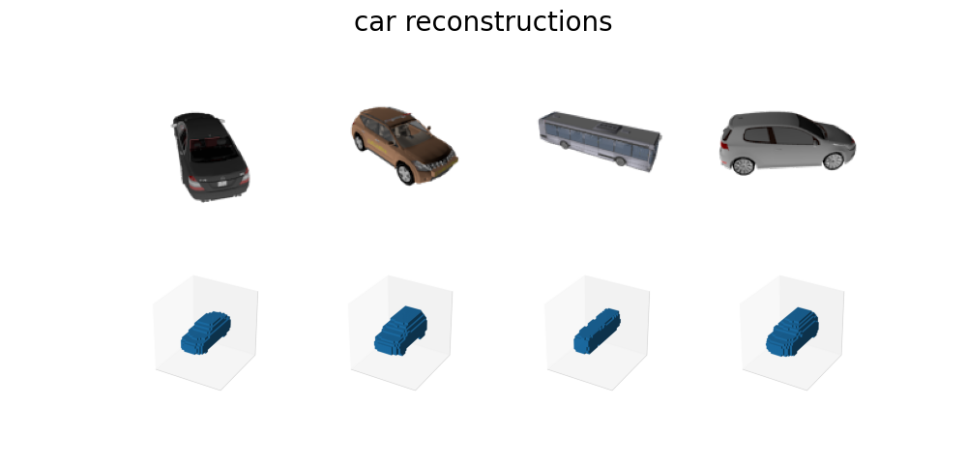
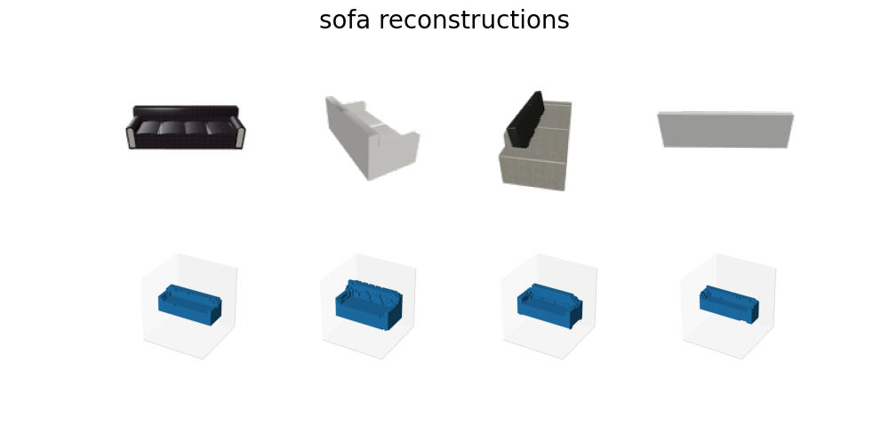
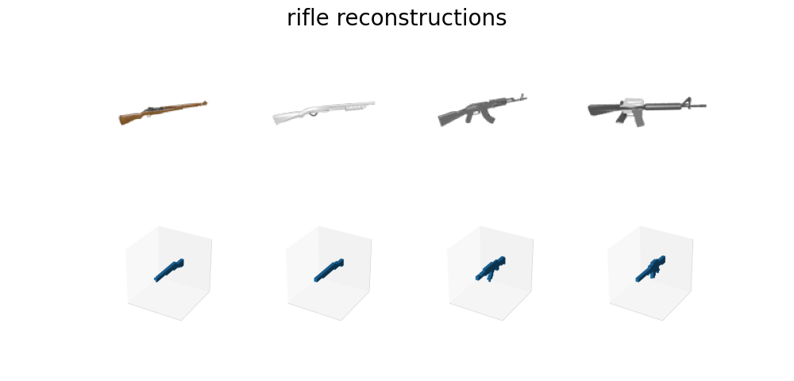
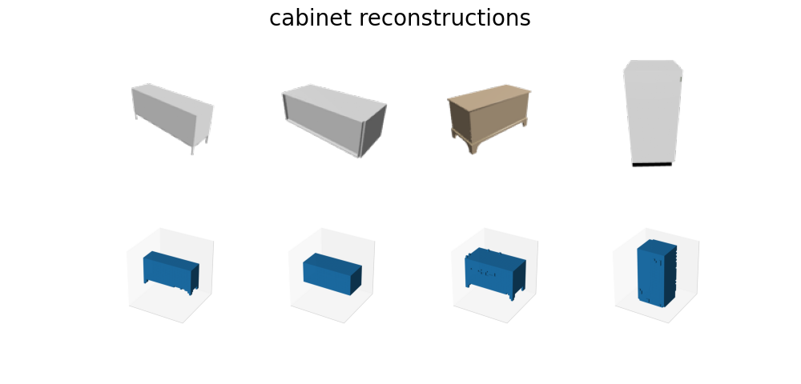
More Fusion Reconstruction Samples

Slide 13
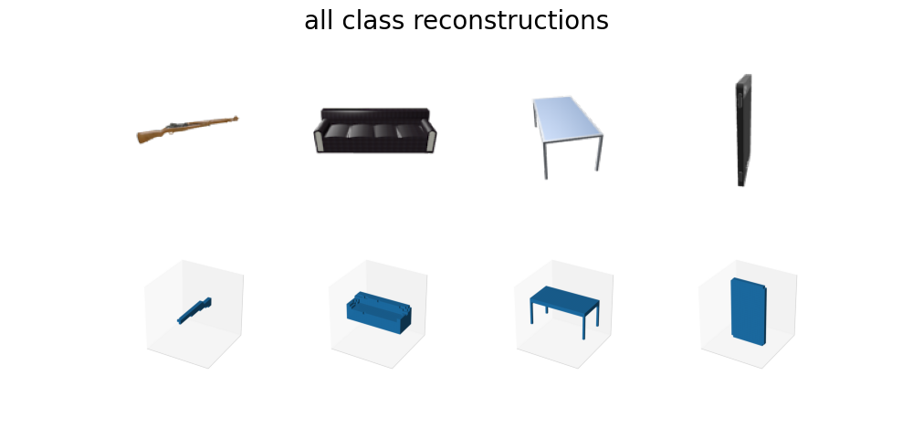
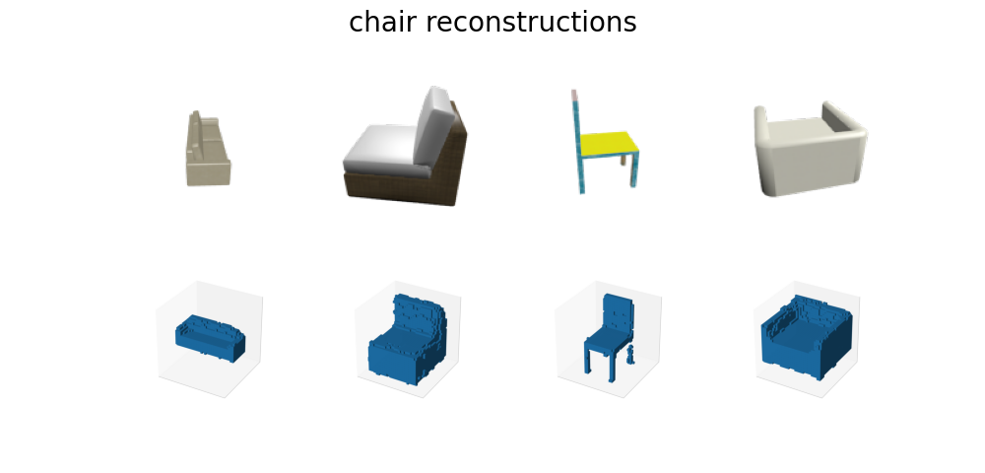
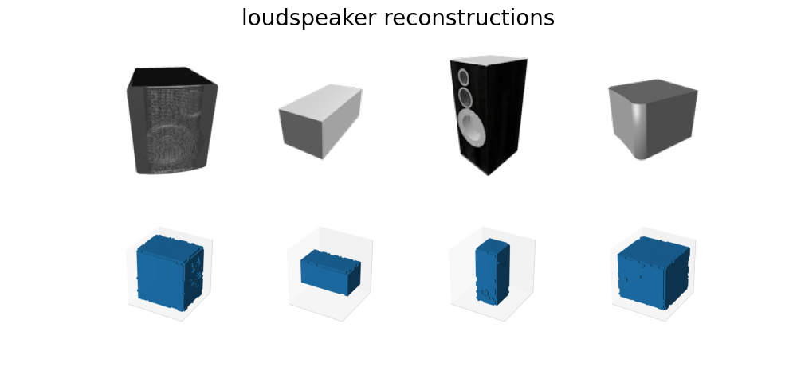
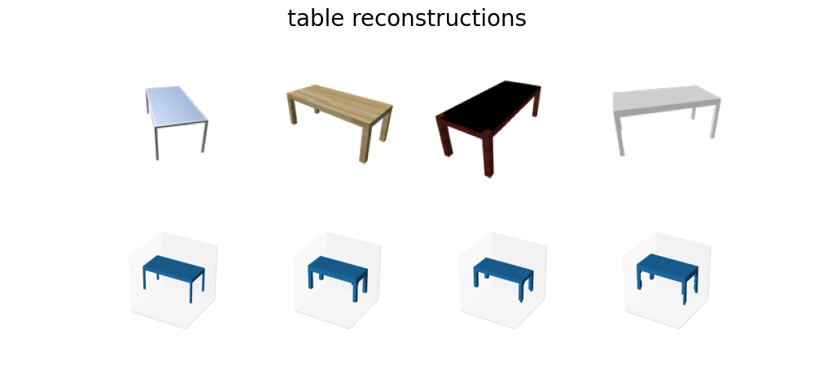
More Fusion Reconstruction Samples 2

Slide 14
Thank You!

Slide 15

Questions?

